Slide 2
DREAM. CONNECT. ACHIEVE.
December 15th, 2024.
Join Us: https://community.cncf.io/cloud-native-baku

Slide 3
AI Research - 2
December 15th, 2024. 11:00-13:00

Slide 4




TechBrains Baku 2024
Lala Ibadullayeva
15 December | #techbrains2024

Slide 5
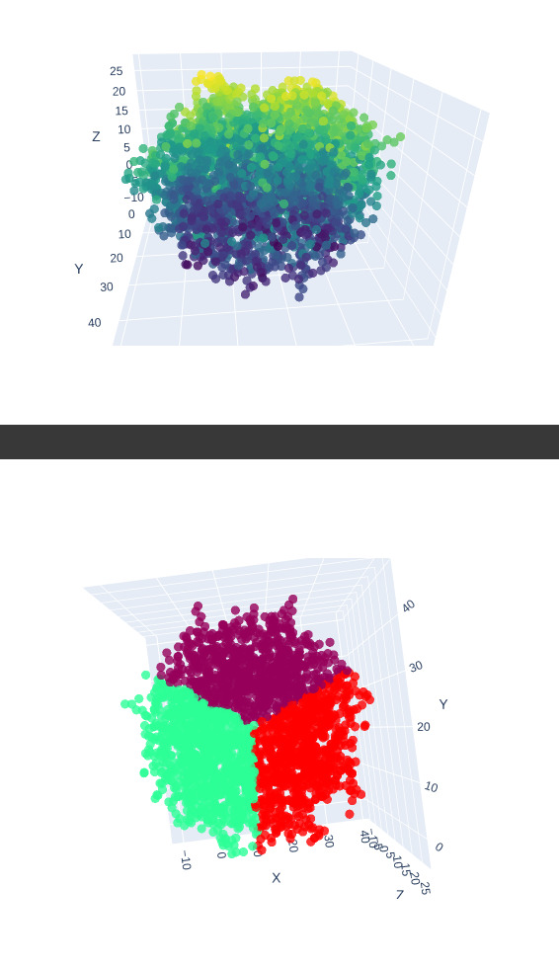
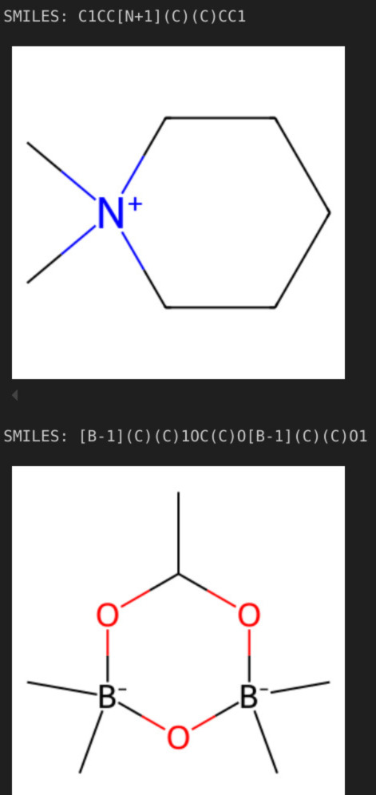
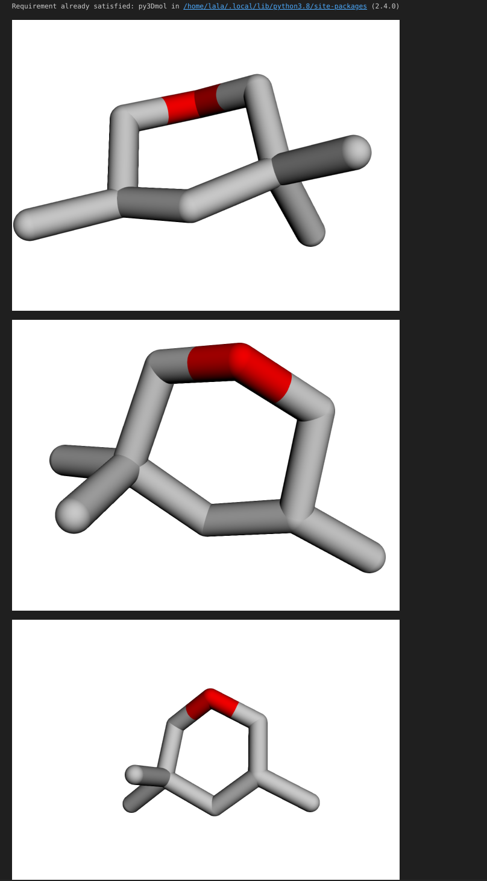
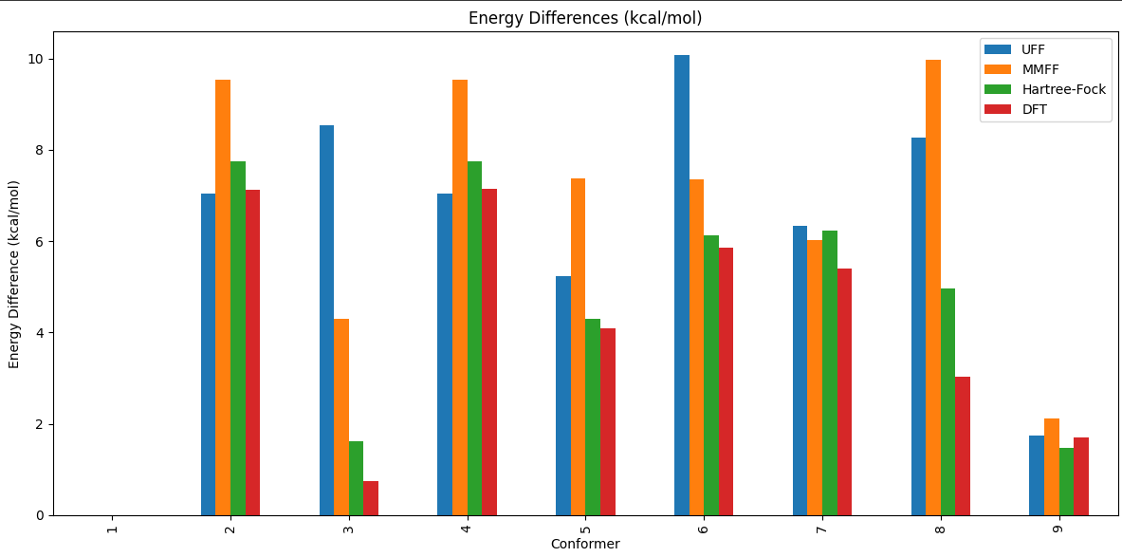


Leveraging Python Open Source Libraries for Biological Data Analysis
Problem Statement: Why do we perform bioinformatics and biological data analysis?
Modern biology produces massive, complex data. Extracting insights from genomics, protein structures, and drug discovery data is vital for understanding biological processes. For instance, analyzing protein structures accelerates drug development. In addition, using data from chemistry increases validity of derived models from sparse experimental data in biology (biology is chemistry with large molecules).
Proposed Solution: Why do we use Python open-source libraries?
Biopython analyzes DNA, RNA, and protein sequences. RDKit offers chemoinformatics calculations and visualisations for ligands. PySCF performs quantum chemistry calculations. NumPy and Pandas enable fast computation and data management. Matplotlib and Plotly create data visualizations. Gemmi facilitates protein structures analysis. 3D PyMOL explores protein structures in 3D.
And finally, why do we calculate energy differences, create plots, and visualize 3D SMILES structures in this process?
Energy differences represent probability of observing one state vs another. 3D SMILES visualization helps in understanding of the atomic structure model.
Lala Ibadullayeva

Slide 6
TRACK 2 - COMPLETE

